Slide 1
Introduction To Manpage and System C
CSE-231 OS

Slide 2
Topics to Cover
Manpages
System Calls
  fork
  open
  opendir
  read
  write
  close

Slide 3

Manpages
If you want had to get an in-depth view regarding a utility or function in Unix/Linux environment, How would you do that?

Slide 4
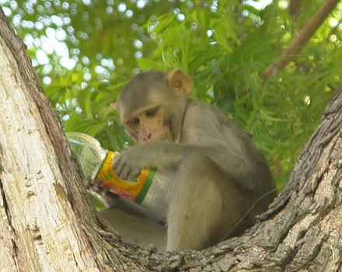
Manpage
Utility program that allows you to view the manual page for a perticular program, concept etc.
Its a form of software documentation found on a Unix or Unix-like system
It covers the following topics
  Computer programs
  Conventions
  Concepts
  Library and System Calls

Slide 5
How to use Manpages in Linux/Unix
Command syntax
man <command_name>
Manpages are referred using the notation “name:(section)”
In linux to address a section you can use the following syntax
man [section_number] <command_name>

Slide 6
Section Table for Man command
1 | General commands`
2 | System calls
3 | Library functions, covering in particular the C standard library
4 | Special files (usually devices, those found in /dev) and drivers
5 | File formats and conventions
6 | Games and screensavers
7 | Miscellaneous
8 | System administration commands and daemons

Slide 7
Manpage Layout
NAME : Name of command followed by a brief description
SYNOPSIS : Formal description of how to run the command
DESCRIPTION: Textual description of the functioning of the command
EXAMPLES : Examples of common usage
SEE ALSO : List of Related commands and functions

Slide 8
DEMO

Slide 9
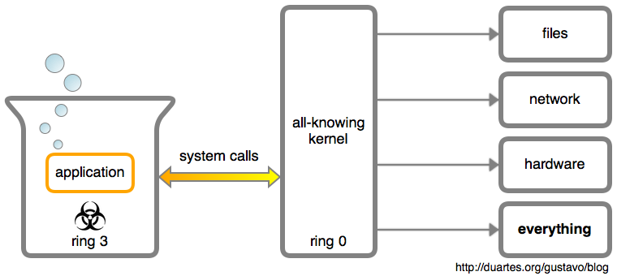
System Calls

Slide 10
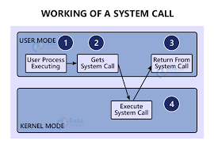
System Call
Programmatic way/ API for requesting a service from the kernel of the Operating System.

Slide 11
Fork system call
Creates a new process
Takes no argument and returns a process id
Return value :
  Negative value : Unsuccessful
  Zero : To child process if successful
  Positive value : To parent the child process id

Slide 12
Open System call
Opens a file specified by filename
Takes path name and flag as argument
Returns a file descriptor that can be used with other system calls
C function interface
int open(const char *pathname, int flags);

Slide 13
Read System Call
Attempts to read upto count into the buffer from fd
C Function interface
ssize_t read(int fd, void *buf, size_t count);

Slide 14
Write System Call
Writes upto n bytes from the buffer into the given file descriptor
ssize_t write(int fd, const void *buf, size_t count);

Slide 15
OpenDir
Opens a directory stream corrosponding to the directory name and returns pointer to the directory stream
C Interface
DIR *opendir(const char *name);
DIR *fdopendir(int fd);

Slide 16
Kill
Sends signal to any process group or processes
C Interface
int kill(pid_t pid, int sig);

